Slide 1
Automating Data Cleaning

Slide 2

The SQL Server Agent
The following slides outline the SQL Server agent which is a key piece of the SQL Server ecosystem.

Slide 3
SQL Server Agent
SQL Server Agent is a Microsoft Windows service that executes scheduled administrative tasks, which are called jobs in SQL Server.
There are 4 main components of the SQL Server agent:
Jobs
Schedules
Alerts
Operators
Citation: Microsoft, SQL Server Agent, learn.microsoft.com

Slide 4

SQL Server Environment Overview
SQL Server (Instance)
SQL Server Agent
SQL Server Job
Step 1
Stored Procedure

Slide 5
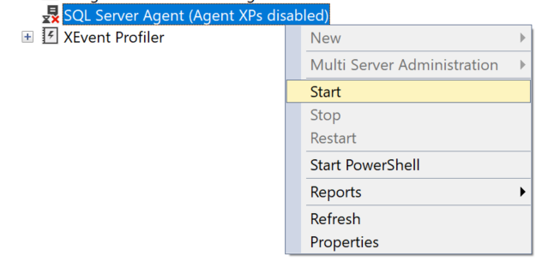
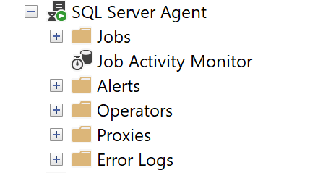
Enabling the SQL Server Agent

Slide 6

SQL Server Alerts
The following slides outline SQL Server alerts use cases, best practices, and implementation details.

Slide 7
SQL Server Alerts
An alert is an automatic response to a specific event. For example, an event can be a job that starts or system resources that reach a specific threshold. You define the conditions under which an alert occurs.
An alert can respond to one of the following conditions:
SQL Server events
SQL Server performance conditions
Microsoft Windows Management Instrumentation (WMI) events on the computer where SQL Server Agent is running
An alert can perform the following actions:
Notify one or more operators
Run a job
Citation: Microsoft, SQL Server Agent Alerts, learn.microsoft.com

